Slide 2
Simple Exponential Smoothing

Slide 3
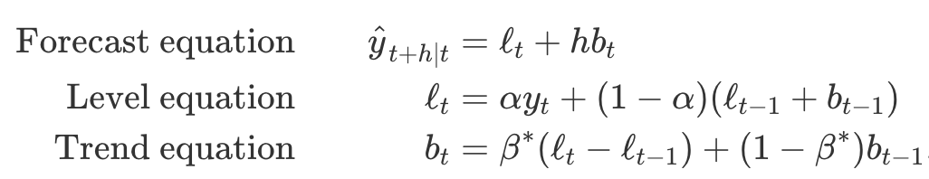
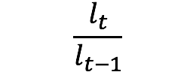
HOLT Linear Trend

Slide 4
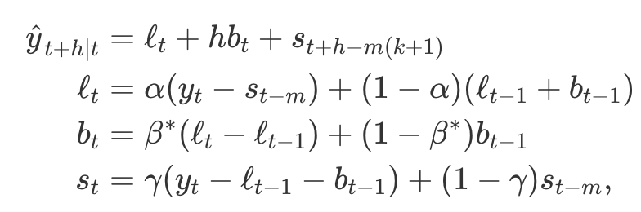
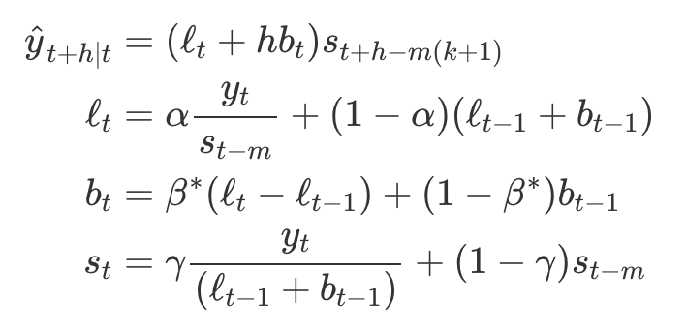
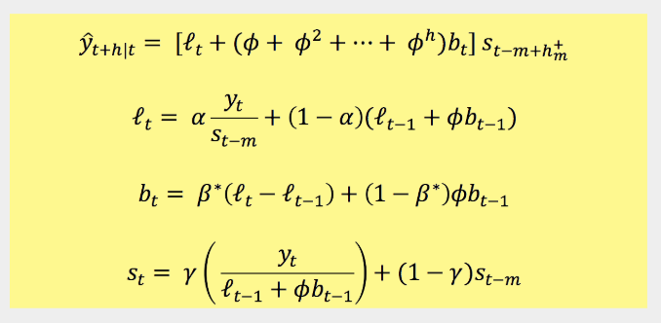
Holt Winters Seasonal Model
m = frequency of the seasonality …
m = 12 for monthly data
m = 4 for quarterly data
Additive
Multiplicative

Slide 5
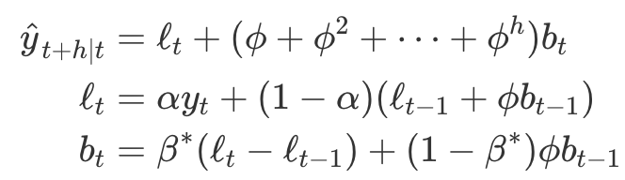
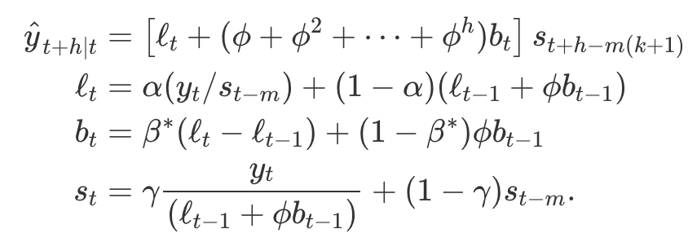
Damped Additive and Multiplicative
Damped Additive Holt
Damped Multiplicative Holt Winters

